Slide 1
R programming for beginners
Introduction
Jason Gullifer

Slide 2
Great interest!
First 40 signups
Special:
Brain imaging
Genome analysis
Machine learning
https://www.r-bloggers.com/in-depth-introduction-to-machine-learning-in-15-hours-of-expert-videos/

Slide 3
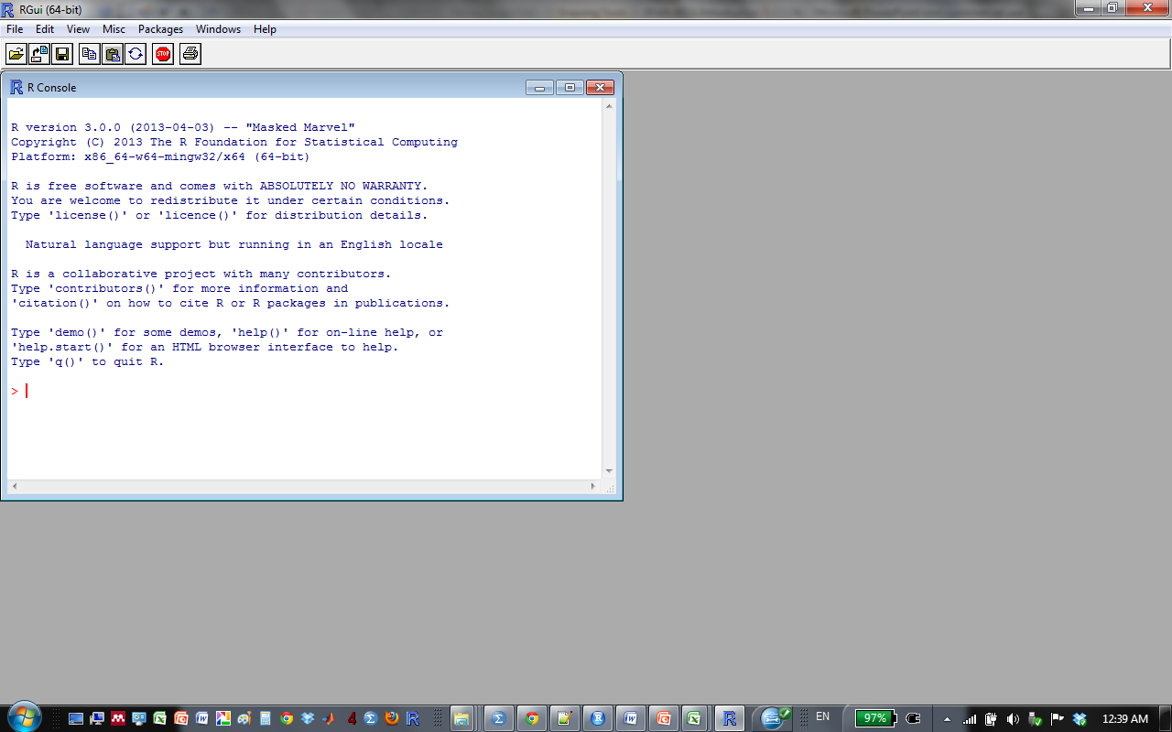
What is R?
R is a software environment for statistical computing and graphics
It's also a programming language.
Runs on multiple platforms (Linux Mac, Windows)
A command-line too that you use to import, process, and analyze data
But there are several front-ends which make it pretty
Downloadable from:
http://www.r-project.org/
http://cran.r-project.org/mirrors.htm

Slide 4
Frontends for R
Frontends available
R-studio
Detailed interface
See variables you’ve defined, plots, etc. in one application
Good for managing projects
https://www.rstudio.com

Slide 5
Frontends for R
Project jupyter (http://jupyter.org)
Reproducible research; incorporate formatted text and R output in one a “notebook”

Slide 6
What can you do with it?
Fancy calculator
Process data
Calculate values per participant / group / etc.
Clean your data (identify and remove outliers)
Prepare data for analysis (get it into the appropriate format/orientation)
trial subject RT
1 1 250
2 1 350
3 1 257
4 1 600
1 2 302
2 2 310
3 2 305
4 2 312
subject mean_RT sd_RT
1 364.25 163.64
2 307.25 4.57

Slide 7
What can you do with it?
Plot data
ggplot (next class!)
Analyze data
T-test
Regression
ANOVA
Mixed-effects regression
PCA/ICA
Mediation analysis

Slide 8
Why use R for processing data (vs. Excel)
Mistakes are generally applied equally
Offset values for everyone
Error messages
Excel: prone to tiny copy paste mistakes
Replicability
Script / text file that you make to accomplish the procedure
Ask yourself
Will I be doing this again?
Will writing a script now save me time in the future?
Is this task really the same thing done over and over again?
Speed
Slowdown with large excel spreadsheet with many formulas
Parallelization in R

Slide 9
Common situation:
You spend hours preparing data by-hand for an adivsor meeting
You calculated your means for each subject in each condition
SDs for each subject in each condition
You even found that error where you calculated the mean from the wrong column
Your spreadsheet is awesome
Advisor: “I think we should exclude xyz trial type” -or- “for our next meeting, we need to see this condition broken down”

Slide 10
Solutions?
By-hand calculations
Spend several more hours redoing the calculations
With R
Add line to the existing script
Hit “Run”
vs

Slide 11
Why use R for analysis (vs. SPSS)
It’s free
McGill provides SPSS but..
License won’t expire during the last chapter of your thesis
Your next university may not offer it…
It’s open source
Public contribution
Public verification
Extensible
An array of community developed packages
Cross platform (Linux, Mac, Win support)

Slide 12
It could help you get a job…

Slide 13
Popularity of statistical packages
Popularity in industry
Popularity in academia
http://r4stats.com/articles/popularity/

Slide 14
Thinking like a computer
Programming can be incredibly frustrating
Also incredibly rewarding
Computers are very powerful and fast
But also incredibly stupid
Programming is mostly figuring out what stupid thing the computer is doing that any human would obviously never do
Practice thinking like a computer with Blockly.

